Slide 1
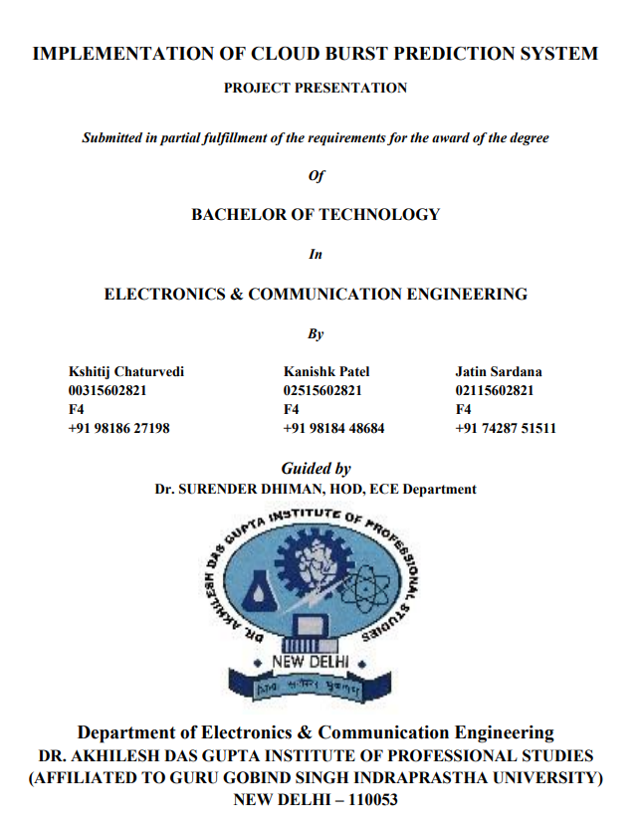

Slide 2


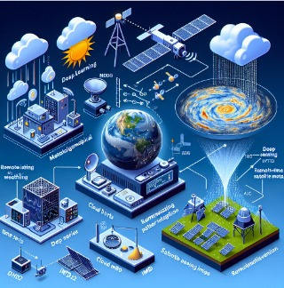

CLOUD BURST PREDICTION
Cloud bursts are sudden and intense rainfall events that can cause catastrophic damage, particularly in hilly regions. The "Cloud Burst Prediction System" project is designed to predict these events using real-time data collection, deep learning algorithms, and hardware sensors. The system's primary goal is to provide timely alerts to authorities to minimize the impact of cloud bursts.
Notes:
2

Slide 3
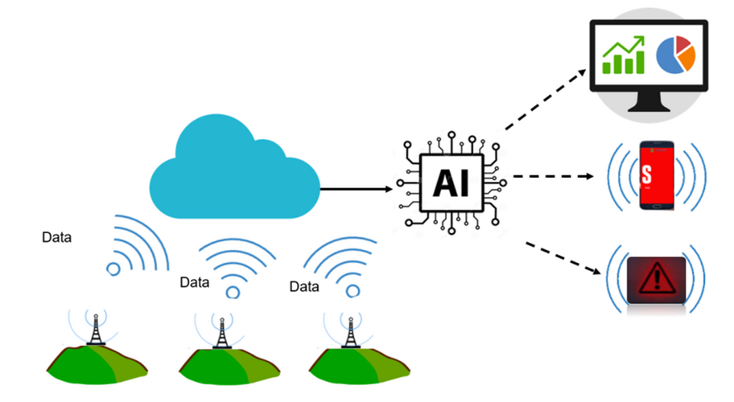
OBJECTIVE
Proposed Solution:
Our solution incorporates a unique Multi-Layered Architecture: This layered approach allows us to tackle cloud burst prediction from both ground-level sensor data and high-altitude satellite observations.
Deep Learning Time Series Model:
Utilizes meteorological data from IMD and Open-Meteo API to analyze historical weather patterns for cloud burst prediction using advanced Time series algorithms like RNN & LSTM.
Real-Time Data Collection with Hardware:
Integrates sensors (e.g., DHT22, BMP180) to collect environmental data, which is fed into the time series model for real-time analysis and prediction refinement.
Notes:
3

Slide 4
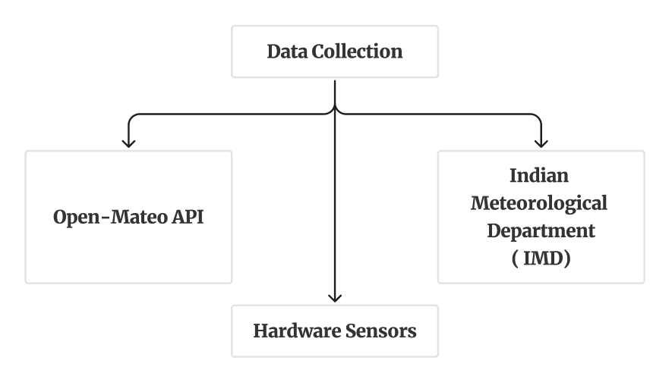
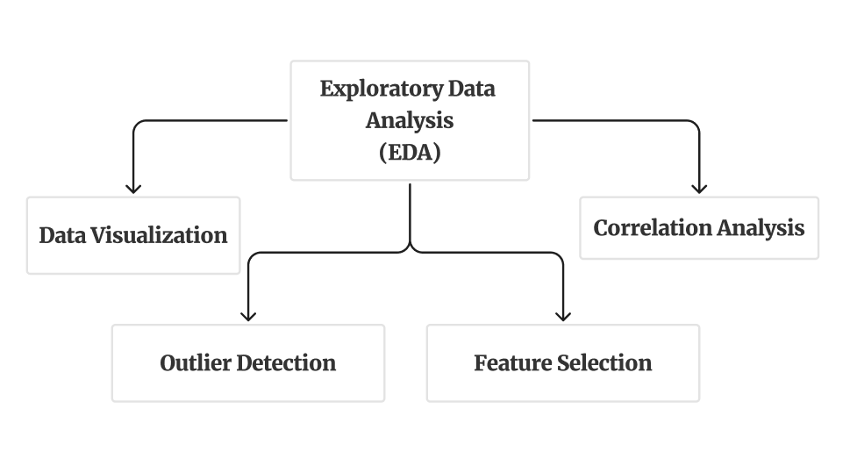
METHEDOLOGY
Notes:
3

Slide 5
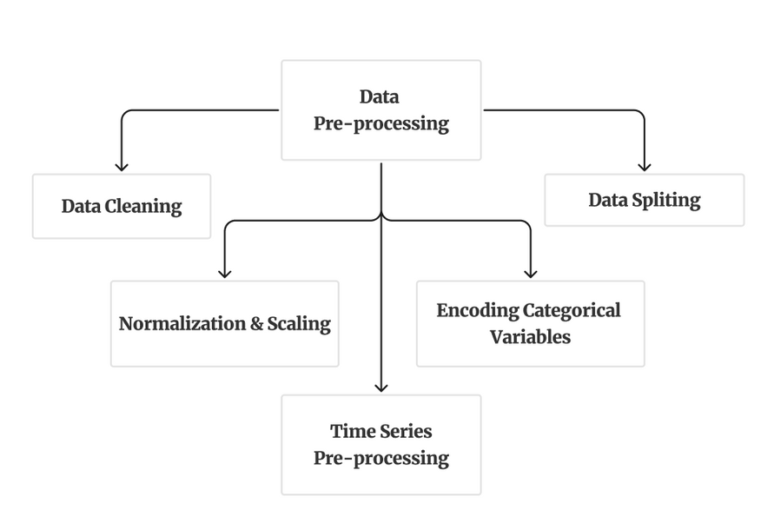
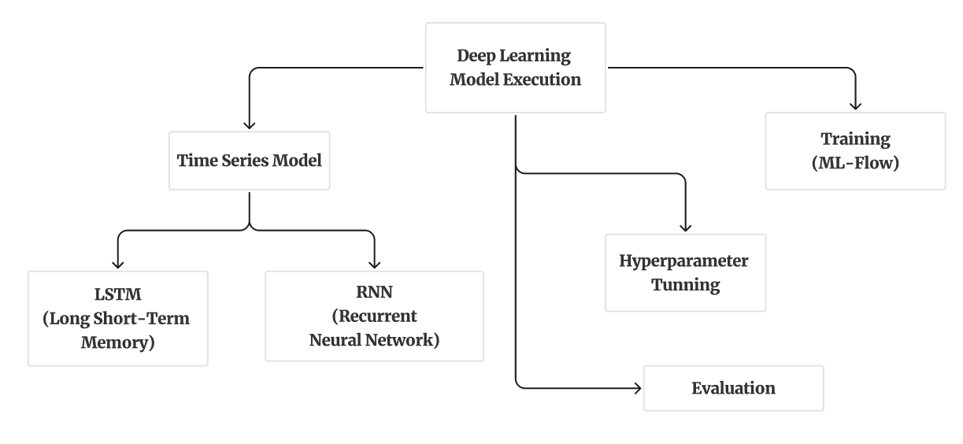
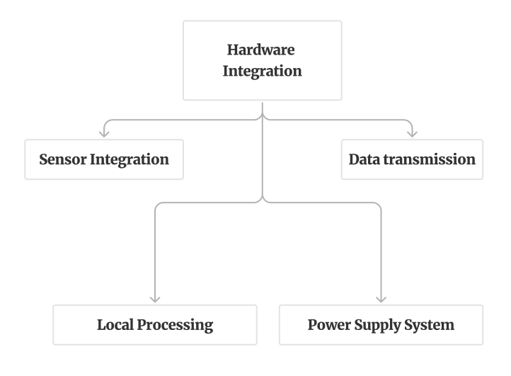
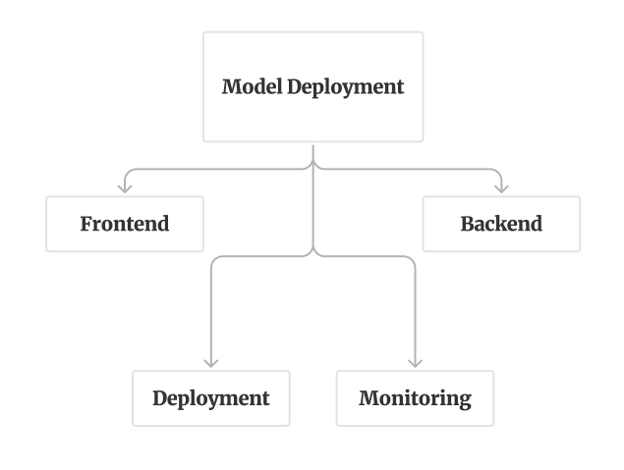
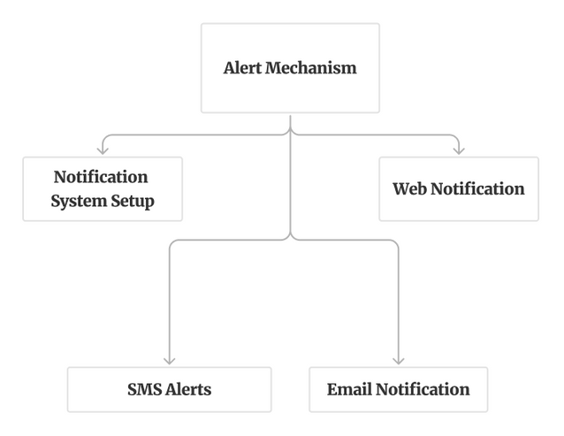
Notes:
3

Slide 6
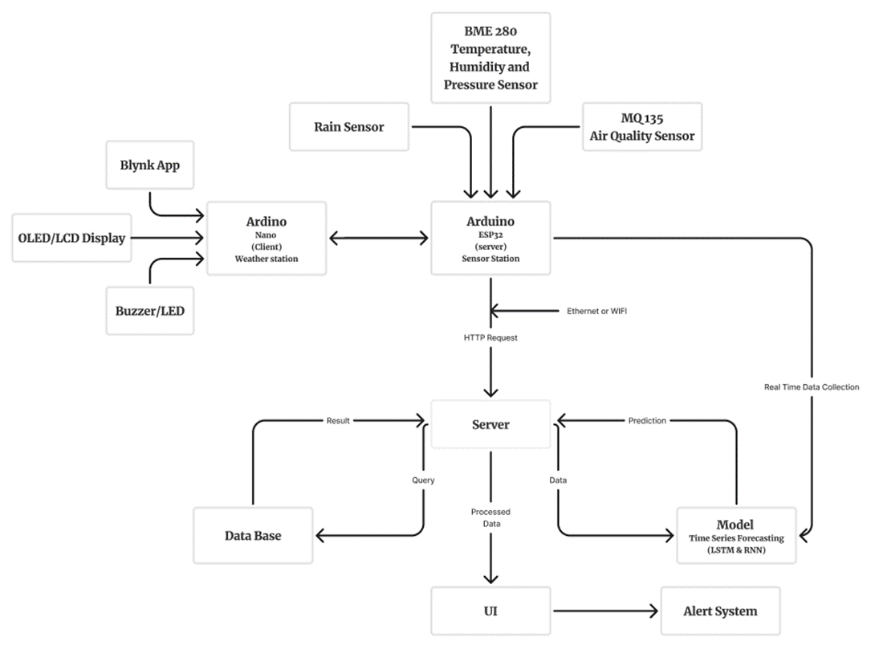
TECHNICAL APPROACH
Technology Stack:
ML & DL Frameworks:
TensorFlow, PyTorch, Keras
Weights & Biases
OpenCV, Yolov5, spaCy
Pandas, scikit-learn, Matplotlib, Seaborn, Plotly
DL Algorithms: RNN, LSTM, & CNN
Server-Side Handling: Python, Flask
Hardware:
Arduino (ESP32, Nano)
Sensors: DHT22, BMP180, LIDAR, Rain Gauge
DB: MySQL, PostgreSQL
MLOps:
Docker, Kubernetes
MLFlow, Data Version Control (DVC), Kubeflow, Terraform
User Interface: Next.js, Tailwind CSS
Deployment: AWS, GCP
Notes:
4

Slide 7
FEASIBILITY AND VIABILITY
1
Idea Feasibility:
Proven Technologies: Open-source frameworks (TensorFlow, PyTorch, MLFlow) and cost-effective hardware (Arduino, DHT22, BMP180) make the solution reliable, scalable, & economical.
Scalable & Adaptable: LSTM and RNN models efficiently manage large datasets and real-time inputs, ensuring scalability.
Seamless Integration: Cloud platforms (AWS, GCP) enable scalable, accessible, and efficient deployment across regions.
2
Potential Challenges & Risks:
Data Retrieval & Quality: Processing large data can be computationally expensive and inconsistent.
Hardware Maintenance: Sensor calibration and reliability are difficult in remote locations.
Connectivity Issues: Power or Wi-Fi outages can disrupt data collection, especially in remote areas.
Model Adaptability: Performance may vary across different geographies and climates.
Abrupt Nature of Cloud Bursts: Cloud bursts can form, travel, and burst within minutes, causing heavy rainfall, floods, and landslides.
3
Strategies for Overcoming Challenges:
Redundant Data Sources: IMD, Open-Meteo, and satellite imagery ensure reliable data despite inconsistencies.
Robust Hardware: Weather-resistant sensors with remote diagnostics and regular calibration reduce maintenance.
Power & Connectivity Backup: Alternative power sources and communication methods (LoRa, GSM) ensure uptime.
Continuous Model Retraining: Regular updates improve performances across regions.
Notes:
5

Slide 8
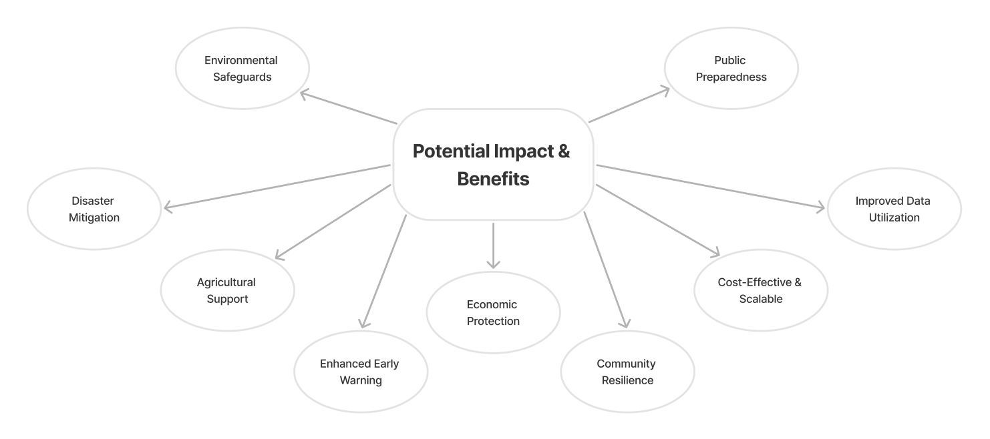
Notes:
5

Slide 9
ADVANTAGES & APPLICATIONS
1
Advantages:
2
Applications:
Early Warning System: Timely alerts to prevent or mitigate disaster impacts.
Accuracy: Combines deep learning and real-time data for precise predictions.
Scalability: Deployable in various regions with different climatic conditions.
Integration: Merges software and hardware for a comprehensive solution.
Disaster Management: Supports timely evacuation and preparation to reduce disaster impact.
Agriculture: Aids in planning by predicting extreme weather.
Urban Planning: Provides data for infrastructure development in high-risk areas.
Notes:
5

Slide 10


1
Use Cases:
Disaster Management & Response: Timely evacuation planning and resource allocation.
Agricultural Support: Crop and livestock protection, and optimized water management for irrigation.
Infrastructure Protection: Flood control and transportation safety, including road closures to prevent accidents from landslides or floods.
Public Safety & Awareness: Mobile alerts (push notifications) and community training for disaster preparedness.
Environmental Conservation: Landslide prevention and wildlife protection.
Urban Planning: Flood mapping for better drainage system design and resilient infrastructure construction.
Insurance Sector: Enhanced risk assessment and claim processing using real-time post-disaster data.
Notes:
6

Slide 11

2
Future Scope:
Remote Sensing and Satellite Imagery: Satellite imagery provides high-resolution satellite data which gives detailed spatial data that can be used to track cloud formation, movement, and other critical atmospheric conditions in real-time.
Notes:
6

Slide 12
RESEARCH & REFERENCES
References:
Related Articles:
Idea Feasibility:
Wikipedia: Weather forecasting - Modern methods. https://en.wikipedia.org/wiki/Weather_forecasting#Modern_method
https://static1.squarespace.com/static/55774404e4b07f2c7dc881a0/t/5ec6c219b10cc30d341f7c8b/1590084123960/Modeling+Clouds+and+Wind.pdf
Open-Mateo API: https://open-meteo.com/
Objective: https://www.ijrti.org/papers/IJRTI2206303.pdf
https://techieyantechnologies.com/a-smart-weather-forecasting-system/
https://docs.arduino.cc/hardware/uno-rev3/
https://imdpune.gov.in/hazardatlas/index3.html
India Meteorological Department (IMD). (2013). A preliminary report on heavy rainfall over Uttarakhand during 16–18 June 2013. India Meteorological Department, Ministry of Earth Sciences.​
https://journals.ametsoc.org/view/journals/hydr/21/7/jhmD190287.xml?tab_body=abstract-display
https://www.tandfonline.com/doi/full/10.1080/02626667.2023.2235349
https://www.sciencedirect.com/science/article/abs/pii/S2212420921007056
https://www.sciencedirect.com/science/article/abs/pii/S0012825216304883
https://link.springer.com/article/10.1007/s43832-022-00020-y
https://www.tandfonline.com/doi/abs/10.1080/2150704X.2020.1723170
https://link.springer.com/article/10.1007/s11069-019-03714-0
https://link.springer.com/chapter/10.1007/978-981-16-5312-4_9
https://link.springer.com/article/10.1007/s11069-019-03829-4
Arduino, G., Reggiani, P., & Todini, E. (2005). Recent advances in flood forecasting and flood risk assessment. Hydrology and Earth System Sciences, 9(4), 280–284.
Srinivasan, J. (2013). Predicting and managing extreme rainfall. Current Science, 105(1), 7–8.
Thayyen, R. J., Dimri, A. P., Kumar, P., & Agnihotri, G. (2013). Study of cloudburst and flash floods around Leh, India, during August 4-6, 2010. Natural Hazards, 65, 2175–2204. doi:10.1007/s11069-012-0464-2.
https://journals.ametsoc.org/view/journals/apme/43/12/jam2173.1.xml?tab_body=pdf
https://journals.ametsoc.org/view/journals/atsc/64/11/2006jas2375.1.xml?tab_body=pdf
https://journals.dbuniversity.ac.in/ojs/index.php/AJET/article/view/353
Notes:
5

